Slide 1
Southern Natural Gas Company 2025 Outage Review
May 21st, 2025

Slide 2
Welcome

Slide 3
Agenda
Review of current and upcoming notable Outages
May/June/July/August
Unscheduled Outages
North System
South System
South Louisiana System
Elba Express Pipeline(EEC)
The next outage meeting will be on June 18th, 2025, at 1:30PM CST
Contacts

Slide 4
Disclaimers
Anticipated Impacts are estimates. Actual nominations, market demand, weather and pipeline conditions, etc. will determine if, and through what level, restrictions become necessary.
Unless otherwise stated, all scheduled dates represent gas days as defined in the Southern Natural Gas Pipeline tariff to mean a period of twenty-four consecutive hours, beginning and ending at 9:00 a.m. (Central Clock Time).
Scheduled dates are subject to change.
Projects may be added, altered, delayed or cancelled.
SNG will provide notice of such additions or changes via Southern’s electronic bulletin board postings.
Dates as posted on the EBB should be deemed correct in the event of conflicts between the EBB posted dates and dates within this presentation.

Slide 5
Color Key for Maps
Yellow
Restrictions are possible
With extended duration, restrictions could be necessary from time to time
Lower than normal pressures may be experienced
Meter(s) affected are noted with (PIN #)
Red
Restrictions are probable

Slide 6
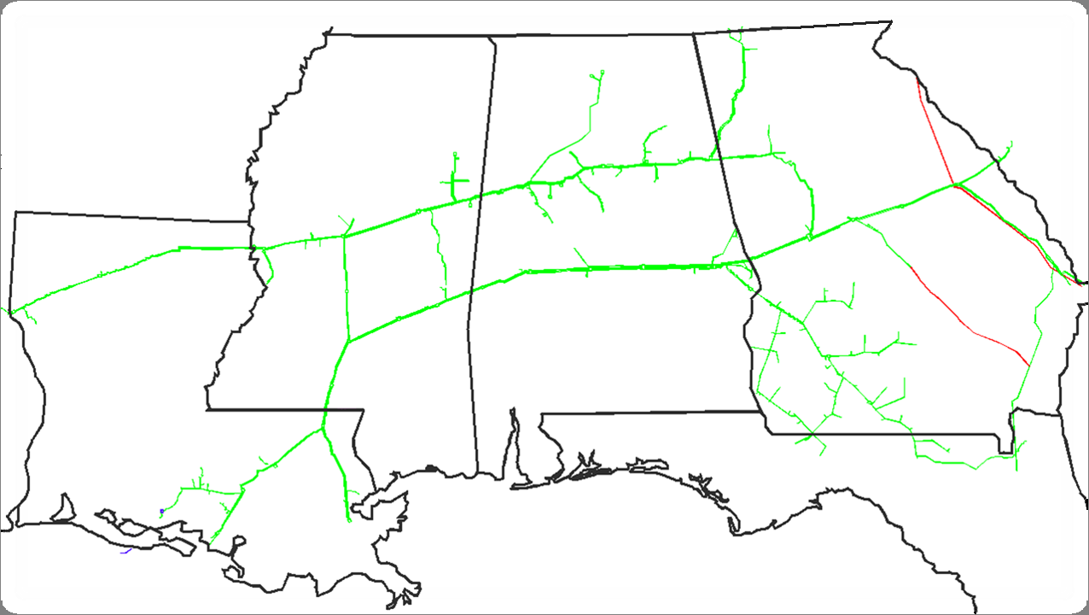
Southern Natural Gas Pipeline
Chattanooga
Rome
SC
Muldon
North System
GA
Hartwell
MS
Tarrant
Bell Mills
Aiken
McConnells
Pell City
DeArmanville
Atlanta
Elba Express
Louisville
Providence
Fairburn
Ocmulgee
Wrens
Pickens
Reform
Ellerslie
Hall Gate
Bear Creek
Onward
Auburn
Jefferson
Thomaston
Rincon
Elba
Bienville
Rankin
Gallion
Selma
Elmore
Holy Trinity
Riceboro
Bay Springs
York
South System
Logansport
Gwinville
Enterprise
Hilliard
AL
LA
Albany
Pearl River
Brookman
Pavo
South Louisiana
Franklinton
White Castle
FL
Toca
Compressor Station
Storage Field
LNG
Shady Side

Slide 7
Southern Natural Gas Pipeline
Unscheduled Outage Update
Chattanooga
Unscheduled Unit Outage
Proj-52723
Thomaston compressor station
1-30-25 to 5-25-25
Seg. 490 capacity of 1,535 Mdth/d impacted up to 40 Mdth/d
Rome
SC
Muldon
North System
GA
Hartwell
MS
Tarrant
Bell Mills
Aiken
McConnells
Pell City
DeArmanville
Atlanta
Elba Express
Louisville
Providence
Fairburn
Ocmulgee
Wrens
Pickens
Reform
Ellerslie
Hall Gate
Bear Creek
Onward
Auburn
Jefferson
Thomaston
Rincon
Elba
Bienville
Rankin
Gallion
Selma
Elmore
Holy Trinity
Riceboro
Bay Springs
York
South System
Logansport
Gwinville
Enterprise
Hilliard
AL
LA
Albany
Pearl River
Brookman
Pavo
South Louisiana
Franklinton
White Castle
FL
Toca
Compressor Station
Storage Field
LNG
Shady Side

Slide 8
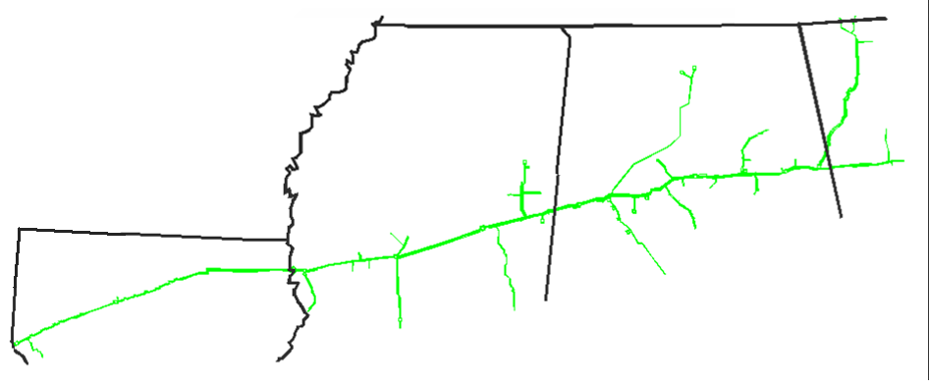
SNG North System Pigging Review
May/June/July/August
Chattanooga
Pigging on Gadsden Branch line
Proj-SNG-5473
5-28-25 to 5-29-25
north of Pell City
Pigging on West Point loop line
Proj-SNG-18566
6-3-25 to 6-6-25
south of Muldon
Huntsville
Rome
GA
Muldon Storage
AL
Tarrant
Bell Mills
Atlanta
McConnells
Pell City
MS
DeArmanville
Louisville
Reform
Providence
Pickens
Onward
Duncanville
Bear Creek Storage
AL
Pigging on 2nd North Main line
Proj-SNG-4754
5-20-25 to 5-22-25
east of McConnells
Logansport
LA
Bienville
Rankin
Compressor Station
Storage Field
LNG
Southern will be conducting other general maintenance during this period

Slide 9
SNG North System Maintenance Review
May/June/July/August
Pipeline Maintenance
North Main line
Proj-SNG-15331/SNG-38939
5-5-25 to 5-31-25
Seg. 130 capacity of 563 Mdth/d impacted 120 Mdth/d
west of Tarrant
Chattanooga
Unit Maintenance
Proj-41251
Pickens compressor station
5-19-25 to 6-6-25
Seg. 400 capacity of 234 Mdth/d impacted 85 Mdth/d
Huntsville
Rome
GA
AL
Muldon Storage
Atlanta
Tarrant
Pell City
Bell Mills
MS
McConnells
Reform
Providence
DeArmanville
Louisville
Pickens
Onward
Bear Creek Storage
Duncanville
Logansport
LA
Pipeline Maintenance
Heflin Lateral line
6-18-25 to 6-20-25
We do not anticipate an impact to customers at this time,
east of Dearmanville
Bienville
Rankin
Pipeline Maintenance
North Main line
6-9-25 to 6-12-25
Seg. 50 capacity of 520 Mdth/d impacted 170 Mdth/d
east of Louisville
Compressor Station
Storage Field
Southern will be conducting other general maintenance during this period

Slide 10
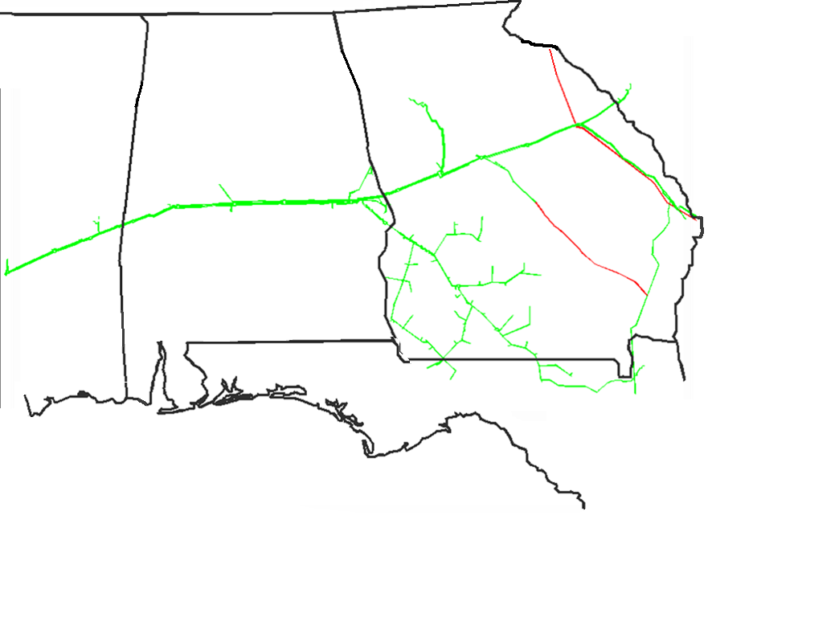
SNG South System Pigging Review
May/June/July/August
Pigging on South Main loop line
Proj-SNG-37217
5-20-25 to 5-22-25
east of Ocmulgee
Hartwell
SC
Pigging on Auburn Grantville loop line
Proj-SNG-15062
7-29-25
north of Auburn
Pigging on South Main loop line
Proj-SNG-11272
6-9-25 to 6-13-25
west of Ellerslie
Aiken
Atlanta
GA
Wrens
Fairburn
Ocmulgee
AL
Hall Gate
Ellerslie
Thomaston
Jefferson
Auburn
Rincon
Elba
Pigging on Phenix City Columbus line
Proj-SNG-4665
7-15-25 to 7-17-25
east of Auburn
MS
Gallion
Selma
Elmore
Holy Trinity
Riceboro
York
Enterprise
Hilliard
Bay Springs
Albany
Gwinville
Pigging on North Terrell Line 6
Proj-SNG-15224
8-26-25 to 8-28-25
south of Holy Trinity
Brookman
Pigging on Main Line 01
Proj-SNG-38132
5-28-25 to 5-30-25
north of Albany
Pavo
FL
Compressor Station
Storage Field
LNG
Southern will be conducting other general maintenance during this period

Slide 11
SNG South System Maintenance Review
May/June/July/August
SC
Unit Maintenance
Proj-52301
Selma compressor station
5-8-25 to 7-13-25
Seg. 460 capacity of 2,293 Mdth/d impacted 165 Mdth/d
Unit Maintenance
Proj-525112
Elmore compressor station
5-19-25 to 5-23-25
Seg. 460 capacity of 2,293 Mdth/d impacted 450 Mdth/d
Hartwell
Atlanta
Aiken
Fairburn
GA
Wrens
Ocmulgee
Station Maintenance
Gwinville compressor station
Proj-5211P6a
5-16-25 to 5-23-25
Seg. 410 capacity of 1,655 Mdth/d impacted 210 Mdth/d
AL
Hall Gate
Jefferson
Auburn
Ellerslie
Rincon
Thomaston
Unit Maintenance
Proj-52833
Hall Gate compressor station
4-28-25 to 5-25-25
Seg. 560 capacity of 705 Mdth/d impacted 70 Mdth/d
Elba
MS
Elmore
Riceboro
Gallion
Selma
Holy Trinity
York
Hilliard
Enterprise
Bay Springs
Pipeline Maintenance
South Main line
Proj-SNG-21939
5-27-25 to 6-6-25
Seg. 440 capacity of 2,300 Mdth/d impacted 55 Mdth/d
east of Gallion
Albany
Gwinville
Brookman
Unit Maintenance
Proj-52113
Gwinville compressor station
5-12-25 to 6-1-25
Seg. 400 capacity of 234 Mdth/d impacted 45 Mdth/d
Pavo
FL
Compressor Station
Storage Field
LNG
Southern will be conducting other general maintenance during this period

Slide 12
SNG South System Maintenance Review continued
May/June/July/August
Pipeline Maintenance
South Main 2nd loop line
Proj-SNG-8793
8-15-25 to 8-24-25
Seg. 460 capacity of 2,293 Mdth/d impacted 135 Mdth/d
east of Selma
Pipeline Maintenance
South Main 2nd loop line
Proj-SNG-8793
8-1-25 to 8-14-25
Seg. 440 capacity of 2,300 Mdth/d impacted 105 Mdth/d
east of Gallion
Hartwell
Atlanta
Aiken
GA
Wrens
SC
Fairburn
Station Maintenance
Gwinville compressor station
Proj-5211P6b
5-27-25 to 5-30-25
Seg. 390 capacity of 1,607 Mdth/d impacted 390 Mdth/d
Ocmulgee
AL
Hall Gate
Jefferson
Auburn
Ellerslie
Rincon
MS
Thomaston
Elba
Gallion
Selma
Elmore
Holy Trinity
Riceboro
York
Hilliard
Enterprise
Bay Springs
Albany
Gwinville
Brookman
Pavo
FL
Compressor Station
Storage Field
LNG
Southern will be conducting other general maintenance during this period

Slide 13
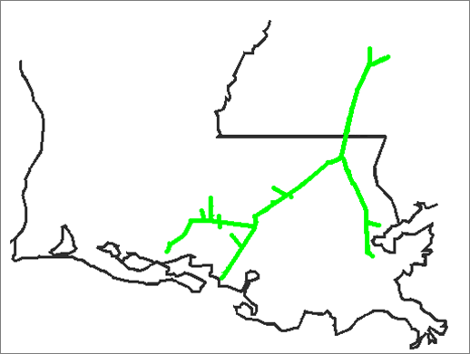
SNG South Louisiana System Pigging Review
May/June/July/August
Pigging on Franklinton Gwinville line
7-22-25 to 7-24-25
Proj-SNG-18722
south of Gwinville
Gwinville
Pearl River
Pigging on Franklinton Gwinville loop line
7-29-25 to 7-30-25
Proj-SNG-5873
8-5-25 to 8-7-25
Proj-SNG-4585
south of Gwinville
MS
LA
Franklinton
West Leg
White Castle
East Leg
Shadyside
Pigging on Erath SS28 line
Proj-SNG-4706
7-14-25 to 7-17-25
south of White Castle
Toca
Compressor Station
Storage Field
Southern will be conducting other general maintenance during this period

Slide 14
SNG South Louisiana System Maintenance Review
May/June/July/August
Pipeline Maintenance
Franklinton Gwinville 2nd loop line
Proj-SNG-36213
7-9-25 to 7-24-25
Seg. 390 capacity of 1,607 Mdth/d impacted 230 Mdth/d
south of Gwinville
Gwinville
SESH planned maintenance affecting SNG capacity
5-21-25
Capacity restricted to 476 Mdth/d
Meters affected
606400 SESH - ENABLE TO SNG
606500 SESH - GULF SOUTH TO SNG
606700 SESH - ETC TIGER TO SNG
All services may be at risk during this maintenance.
Pearl River
MS
Pipeline Maintenance
Duck Lake Franklinton line
Proj-SNG-2753
5-22-25 to 6-5-25
Proj-SNG-22856
8-25-25 to 8-29-25
Seg. 350 capacity of 695 Mdth/d impacted 160 Mdth/d
north of White Castle
LA
Franklinton
West Leg
White Castle
East Leg
Shadyside
Toca
Compressor Station
Storage Field
Southern will be conducting other general maintenance during this period

Slide 15
EEC Line Pigging and Maintenance Review
May/June/July/August
Rome
SC
Muldon
North System
GA
Hartwell
MS
Tarrant
Bell Mills
Aiken
McConnells
Atlanta
Pell City
DeArmanville
Hall Gate
Elba Express
Louisville
Providence
Fairburn
Ocmulgee
Wrens
Pickens
Reform
Ellerslie
Jefferson
Bear Creek
Onward
Duncanville
Auburn
Thomaston
Rincon
Elba
Rankin
Bay Springs
Gallion
Selma
Elmore
Holy Trinity
Riceboro
Bienville
York
South System
Gwinville
Enterprise
Hilliard
AL
LA
Albany
Pearl River
Brookman
Pavo
South Louisiana
Franklinton
FL
White Castle
Toca
Shady Side

Slide 16
SNG North System Pigging Review
Remainder of the year
Pigging on Chattanooga Branch line
Proj-SNG-29149
11-11-25 to 11-14-25
north of Bell Mills
Chattanooga
Huntsville
Rome
GA
Muldon Storage
AL
Tarrant
Bell Mills
Atlanta
McConnells
Pell City
MS
Reform
DeArmanville
Louisville
Providence
Pickens
Onward
Pigging on Rome Calhoun line
Proj-SNG-4763
11-11-25 to 11-13-25
south of Rome
Bear Creek Storage
Duncanville
Logansport
LA
Bienville
Rankin
Compressor Station
Storage Field
Southern will be conducting other general maintenance during this period

Slide 17
SNG North System Maintenance Review
Remainder of the year
Muldon Shut-in test
10-7-25 to 9 AM 10-14-25
Restrictions first into ISS then CSS-not to exceed 36% of CSS DIQ /DWQ
Chattanooga
Bear Creek Shut-in test
10-21-25 to 9 AM 10-28-25
Restrictions first into ISS then CSS-not to exceed 64% of CSS DIQ /DWQ
Huntsville
Rome
GA
AL
Muldon Storage
Atlanta
Tarrant
Pell City
Bell Mills
MS
McConnells
Reform
Providence
DeArmanville
Louisville
Pickens
Onward
Bear Creek Storage
Duncanville
Logansport
Bienville
LA
Rankin
Compressor Station
Storage Field
Southern will be conducting other general maintenance during this period

Slide 18
SNG South System Pigging Review
Remainder of the year
Pigging on Brunswick line
Proj-SNG-9076
12-8-25 to 12-12-25
south of Ocmulgee
SC
Hartwell
Aiken
Atlanta
GA
Wrens
Fairburn
Ocmulgee
AL
Hallgate
Jefferson
Auburn
Ellerslie
Rincon
Thomaston
Elba
MS
Gallion
Selma
Elmore
Holy Trinity
Riceboro
York
Hilliard
Enterprise
Bay Springs
Albany
Gwinville
Brookman
Pavo
FL
Compressor Station
Storage Field
LNG
Southern will be conducting other general maintenance during this period

Slide 19
SNG South System Maintenance Review
Remainder of the year
SC
Hartwell
Aiken
Atlanta
GA
Wrens
Fairburn
Ocmulgee
AL
Hallgate
Jefferson
Auburn
Ellerslie
Rincon
Thomaston
Elba
MS
Elmore
Riceboro
Gallion
Selma
Holy Trinity
Hilliard
York
Enterprise
Bay Springs
Albany
Gwinville
Brookman
Pavo
FL
Compressor Station
Storage Field
LNG
Southern will be conducting other general maintenance during this period

Slide 20
SNG South Louisiana System Pigging Review
Remainder of the year
Gwinville
Pearl River
MS
LA
Franklinton
West Leg
White Castle
East Leg
Shadyside
Toca
Compressor Station
Storage Field
Southern will be conducting other general maintenance during this period

Slide 21
SNG South Louisiana System Maintenance Review
Remainder of the year
Gwinville
Pipeline Maintenance
White Castle Franklinton loop line
Proj-SNG-22856
9-3-25 to 9-8-25
Seg. 350 capacity of 735 Mdth/d impacted 100 Mdth/d
Proj-SNG-2933/SNG-3089
9-8-25 to 10-7-25
Seg. 350 capacity of 735 Mdth/d impacted 200 Mdth/d
north of White Castle
Pearl River
MS
LA
Pipeline Maintenance
Duck Lake Franklinton line
Proj-SNG-2933
10-13-25 to 11-3-25
Seg. 350 capacity of 735 Mdth/d impacted 15 Mdth/d
north of White Castle
Franklinton
West Leg
White Castle
East Leg
Shadyside
Toca
Compressor Station
Storage Field
Southern will be conducting other general maintenance during this period

Slide 22
EEC Line Pigging and Maintenance Review
Remainder of the year
Rome
SC
Muldon
North System
GA
Hartwell
MS
Tarrant
Bell Mills
Aiken
McConnells
Atlanta
Louisville
Pell City
DeArmanville
Fairburn
Hall Gate
Wrens
Pickens
Reform
Providence
Ocmulgee
Onward
Ellerslie
Jefferson
Bear Creek
Auburn
Thomaston
Rincon
Elba
Rankin
Gallion
Selma
Elmore
Holy Trinity
Riceboro
Bienville
York
South System
Gwinville
Enterprise
Hilliard
Bay Springs
AL
LA
Albany
Pearl River
Brookman
Pavo
South Louisiana
Franklinton
FL
White Castle
Toca
Shady Side

Slide 23
Gas Control Contacts
Skyler Spyker – Manager
(713) – 420 – 2386 (office)
(806)-470-7743 (cell)
skyler_spyker@kindermorgan.com
Mario Murillo – Outage Coordinator
(281) – 753 – 6530 (cell)
mario_murillo@kindermorgan.com
Jimmy Reese – Lead Controller
(205) – 577 – 3204 (cell)
jimmy_reese@kindermorgan.com
Darren LaPoint – Lead Controller
(713) – 927 – 3894 (cell)
darren_lapoint@kindermorgan.com

Slide 24
Questions?

