Slide 1
Southern Natural Gas Company 2024 Outage Review
August 21st , 2024

Slide 2
Welcome

Slide 3
Agenda
Review of current and upcoming notable Outages
August/September/October/November
Unscheduled outages
North System
South System
South Louisiana System
EEC
The next outage meeting will be on September 18th, 2024, at 1:30PM CST
Contacts

Slide 4
Disclaimers
Anticipated Impacts are estimates. Actual nominations, market demand, weather and pipeline conditions, etc. will determine if, and through what level, restrictions become necessary.
Unless otherwise stated, all scheduled dates represent gas days as defined in the Southern Natural Gas Pipeline tariff to mean a period of twenty-four consecutive hours, beginning and ending at 9:00 a.m. (Central Clock Time).
Scheduled dates are subject to change.
Projects may be added, altered, delayed or cancelled.
SNG will provide notice of such additions or changes via Southern’s electronic bulletin board postings.
Dates as posted on the EBB should be deemed correct in the event of conflicts between the EBB posted dates and dates within this presentation.

Slide 5
Color Key for Maps
Yellow
Restrictions are possible
With extended duration, restrictions could be necessary from time to time
Lower than normal pressures may be experienced
Meter(s) affected are noted with (PIN #)
Red
Restrictions are probable

Slide 6
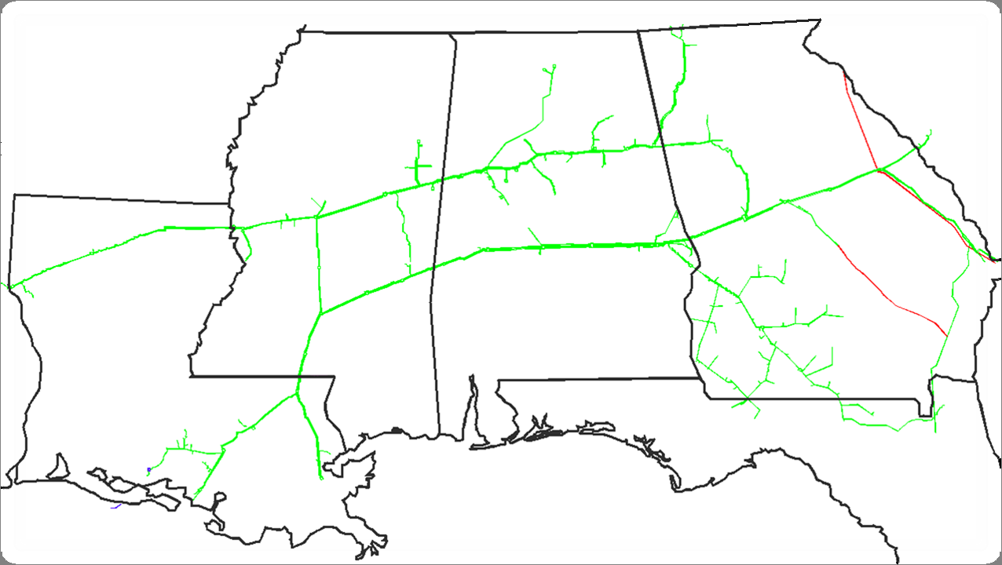
Southern Natural Gas Pipeline
Chattanooga
Rome
SC
Muldon
North System
GA
Hartwell
MS
Tarrant
Bell Mills
Aiken
McConnells
Atlanta
Elba Express
Pell City
DeArmanville
Wrens
Louisville
Providence
Ocmulgee
Pickens
Reform
Ellerslie
Hall Gate
Bear Creek
Onward
Auburn
Thomaston
Rankin
Selma
Elba
Bienville
Gallion
Elmore
Holy Trinity
Bay Springs
York
South System
Riceboro
Logansport
Gwinville
Enterprise
AL
LA
Albany
Pearl River
Brookman
Pavo
South Louisiana
Franklinton
White Castle
FL
Toca
Compressor Station
Storage Field
LNG
Shady Side

Slide 7
Southern Natural Gas Pipeline
Unscheduled Outage Update
Chattanooga
Unscheduled unit outage
Rankin compressor station
Proj-46102
8-6-24 to 9-1-24
Rome
SC
Muldon
North System
GA
Hartwell
MS
Tarrant
Bell Mills
Aiken
McConnells
Atlanta
Elba Express
Pell City
DeArmanville
Wrens
Louisville
Providence
Ocmulgee
Pickens
Reform
Ellerslie
Hall Gate
Bear Creek
Onward
Auburn
Thomaston
Rankin
Selma
Elba
Bienville
Gallion
Elmore
Holy Trinity
Bay Springs
York
South System
Riceboro
Logansport
Gwinville
Enterprise
AL
LA
Albany
Pearl River
Unscheduled unit outage Gallion compressor station
11-29-23 to 10-31-24
Brookman
Pavo
South Louisiana
Franklinton
White Castle
FL
Toca
Compressor Station
Storage Field
LNG
Shady Side

Slide 8
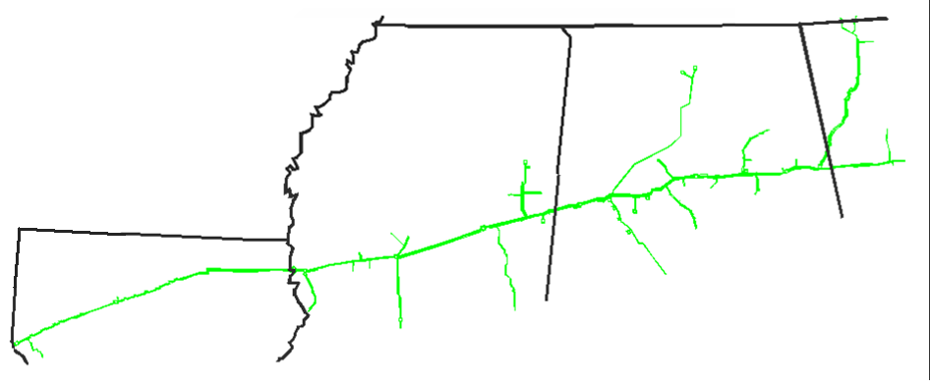
SNG North System Pigging Review
August/September/October/November
Chattanooga
Huntsville
AL
Rome
Muldon Storage
Atlanta
MS
Tarrant
Pell City
Bell Mills
McConnells
Reform
Providence
DeArmanville
Louisville
GA
Pickens
Pigging on NMLL
10-1-24 to 10-2-24
Proj-15346-east of Tarrant
Onward
Bear Creek Storage
AL
Logansport
Bienville
Rankin
Pigging on Miss. Chemical line
8-27-24
Proj-18560-west of Pickens
LA
Pigging on Miss. Chemical LL
8-29-24
Proj-18562-west of Pickens
Compressor Station
Storage Field
LNG
Southern will be conducting other general maintenance during this period

Slide 9
SNG North System Maintenance Review
August/September/October/November
Muldon Shut-in test
10-1-24 to 10-7-24
Restrictions first into ISS then CSS-not to exceed 36% of CSS DIQ /DWQ
Chattanooga
Huntsville
AL
Rome
Muldon unit maintenance
9-9-24 to 11-8-24
Muldon Storage
Atlanta
MS
Tarrant
Pell City
Bell Mills
McConnells
Reform
Providence
DeArmanville
Louisville
GA
Pickens
Pipeline maintenance Bessemer Calera line and loop line
5-28-24 to 9-13-24
9-14-24 to 9-18-24
10-15-24 to 10-19-24
10-22-24 to 10-26-24
east of Providence
Pipeline maintenance Talladega Branch loop line
9-6-24 to 10-25-24
Proj-36904 south of Dearmanville
Onward
Bear Creek Storage
AL
Logansport
Bienville
Rankin
Bear Creek Shut-in test
10-15-24 to 9 AM 10-21-24
Restrictions first into ISS then CSS-not to exceed 64% of CSS DIQ /DWQ
LA
Compressor Station
Storage Field
Southern will be conducting other general maintenance during this period

Slide 10
SNG North System Maint. Review Cont.
August/September/October/November
Chattanooga
Huntsville
AL
Rome
Muldon Storage
Atlanta
MS
Tarrant
Pell City
Bell Mills
McConnells
Reform
Providence
DeArmanville
Louisville
GA
Pickens
Onward
Pipeline maintenance 2ndNML
10-10-24 to 10-13-24
Seg. 120 capacity of 652 Mdth/d impacted up to 355 Mdth/d
east of Providence
Bear Creek Storage
AL
Logansport
Bienville
Rankin
Pipeline maintenance 2ndNML
10-8-24 to 10-16-24
Seg. 400 capacity of 234 Mdth/d impacted up to 84 Mdth/d
Proj-2328 east of Pickens
LA
Compressor Station
Storage Field
Southern will be conducting other general maintenance during this period

Slide 11
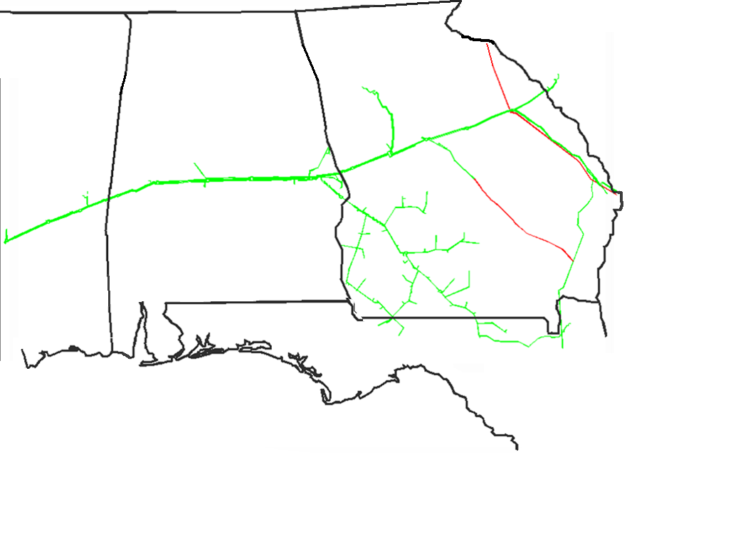
SNG South System Pigging Review
August/September/October/November
MS
Pigging on SMLL 9-24-24
Proj-18931 west of Ellerslie
Pigging on Ocmulgee Atlanta line-Ocmulgee to Bass Junction 9-17-24 to 9-18-24
Hartwell
Atlanta
Aiken
GA
Wrens
Ocmulgee
AL
Hallgate
Auburn
Ellerslie
Thomaston
Elba
Gallion
Selma
Elmore
Holy Trinity
Riceboro
York
Enterprise
Pigging on North Terrell line 6 9-4-24 to 9-7-24
Exact date TBD
Proj-15224 south of Holy Trinity
Bay Springs
Albany
Gwinville
Brookman
Pavo
Compressor Station
Storage Field
LNG
Southern will be conducting other general maintenance during this period

Slide 12
SNG South System Maintenance Review
August/September/October/November
Pipeline maintenance SML
9-9-24 to 9-18-24
We do not anticipate an impact to customers
Proj-2496B
east of Ocmulgee
MS
Gallion unit maintenance
9-23-24 to 9-24-24
Seg. 440 capacity of 2,300 Mdth/d impacted 265 Mdth/d
Hartwell
Atlanta
Aiken
GA
Wrens
Gwinville unit maintenance Proj-52677
8-12-24 to 9-11-24
Seg. 390 capacity of 1,607 Mdth/d impacted 30 Mdth/d
Ocmulgee
AL
Hallgate
Auburn
Ellerslie
Thomaston
Rincon
Elba
Gallion
Selma
Elmore
Holy Trinity
Riceboro
York
Enterprise
Thomaston unit outage
5-23-24 to 9-30-24
Seg. 490 Cap. Of 1,535 Mdth/d impacted 170 Mdth/d
Bay Springs
Elmore unit maintenance
9-25-24 to 9-26-24
Seg. 460 capacity of 2,293 Mdth/d impacted 450 Mdth/d
Albany
Gwinville
Holy Trinity station outage
10-7-24 to 10-12-24
Seg. 655 Cap. of 127 Mdth/d impacted 37 Mdth/d
Brookman
Pavo
Compressor Station
Storage Field
LNG
Southern will be conducting other general maintenance during this period

Slide 13
SNG South System Maint. Review cont.
August/September/October/November
MS
Pipeline maintenance
TG2ndLL
10-7-24 to 10-16-24
north of Thomaston
Proj-231009
Elmore unit maintenance
10-17-24
Seg. 460 capacity of 2,293 Mdth/d impacted 450 Mdth/d
Hartwell
Atlanta
Aiken
Gallion unit maintenance
10-15-24
Seg. 440 capacity of 2,300 Mdth/d impacted 445 Mdth/d
GA
Wrens
Ocmulgee
AL
Hallgate
Auburn
Ellerslie
Thomaston
Rincon
Elba
Gallion
Selma
Elmore
Holy Trinity
Riceboro
York
Selma station maintenance
10-1-24 to 10-28-24
Seg. 460 capacity of 2,273 Mdth/d impacted 265 Mdth/d
Proj-2593
Auburn unit maintenance
10-7-24 to 10-8-24
Seg. 460 capacity of 2,293 Mdth/d impacted 340 Mdth/d
Enterprise
Bay Springs
York station maintenance
10-14-24
Seg. 430 capacity of 2,306 Mdth/d impacted 340 Mdth/d
Albany
Gwinville
Brookman
Pavo
Auburn unit maintenance
10-18-24
Seg. 460 capacity of 2,293 Mdth/d impacted 340 Mdth/d
Compressor Station
Storage Field
LNG
York unit maintenance
10-23-24 to 10-24-24
Seg. 430 capacity of 2,306 Mdth/d impacted 340 Mdth/d
Southern will be conducting other general maintenance during this period

Slide 14
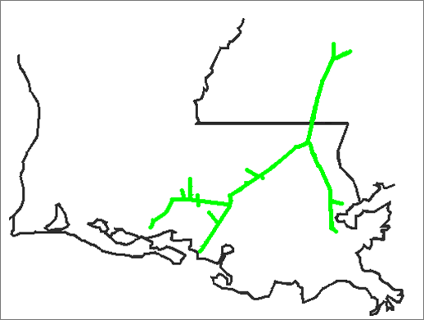
SNG South Louisiana System Pigging Review
August/September/October/November
Gwinville
Pearl River
MS
LA
Franklinton
West Leg
White Castle
Toca
East Leg
Shadyside
Compressor Station
Storage Field
Southern will be conducting other general maintenance during this period

Slide 15
SNG South Louisiana System Maint. Review
August/September/October/November
Pipeline maintenance
FGLL
8-19-24 to 8-26-24
Seg. 370 cap. 1,123 Mdth/d impacted 150 Mdth/d north of Pearl River
Gwinville
Pearl River station outage
9-20-24 to 10-4-24
Seg. 370 cap. of 1,123 Mdth/d impacted 280 Mdth/d
Pipeline maintenance
FG2ndLL
8-29-24 to 9-6-24
Seg. 370 cap. 1,123 Mdth/d impacted 160 Mdth/d north of Pearl River
Pearl River
MS
LA
Franklinton
Franklinton unit maintenance
8-12-24 to 8-30-24
West Leg
White Castle
Toca
East Leg
Shadyside
Compressor Station
Storage Field
Southern will be conducting other general maintenance during this period

Slide 16
SNG South Louisiana System Maint. Review Cont.
August/September/October/November
Pipeline maintenance on WCFLL
10-4-24 to 11-1-24
Seg. 350 cap. 735 Mdth/d impacted 200 Mdth/d
Proj-2861-north of White Castle
Pipeline maintenance on FGL
9-13-24 to 10-3-24
Seg. 370 cap. of 1,123 Mdth/d impacted 180 Mdth/d
south of Pearl River
Gwinville
Pearl River
Pipeline maintenance
DLFL
9-4-24 to 9-14-24
Seg. 350 cap. 735 Mdth/d impacted 115 Mdth/d
9-15-24 to 10-3-24
Seg. 350 cap. 735 Mdth/d impacted 15 Mdth/d
Proj-2754-north of White Castle
MS
Pipeline maintenance on FGLL
10-11-24 to 10-18-24
Seg. 370 cap. of 1,123 Mdth/d impacted 190 Mdth/d
south of Pearl River
LA
Franklinton
Pipeline maintenance on FG2ndLL
10-18-24 to 10-25-24
Seg. 370 cap. of 1,123 Mdth/d impacted 200 Mdth/d
south of Pearl River
West Leg
White Castle
Toca
East Leg
Shadyside
Compressor Station
Storage Field
Southern will be conducting other general maintenance during this period

Slide 17
EEC Line
August/September/October/November
Rome
SC
Muldon
North System
GA
Hartwell
MS
Tarrant
Bell Mills
Aiken
McConnells
Atlanta
Elba Express
Reform
DeArmanville
Hall Gate
Wrens
Louisville
Providence
Pell City
Ocmulgee
Pickens
Ellerslie
Bear Creek
Onward
Auburn
Thomaston
Rankin
Selma
Elba
Bay Springs
Gallion
Elmore
Holy Trinity
Bienville
York
South System
Riceboro
Gwinville
Enterprise
AL
LA
Albany
Pearl River
Brookman
Pavo
South Louisiana
Franklinton
White Castle
FL
Toca
Shady Side

Slide 18
SNG North System Pigging Review
Remainder of year
Chattanooga
Huntsville
AL
Rome
Muldon Storage
Atlanta
MS
Tarrant
Pell City
Bell Mills
McConnells
Reform
Providence
DeArmanville
Louisville
GA
Pickens
Onward
Bear Creek Storage
AL
Logansport
Bienville
Rankin
LA
Compressor Station
Storage Field
Southern will be conducting other general maintenance during this period

Slide 19
SNG North System Maint. Review
Remainder of year
Huntsville
AL
Rome
Muldon Storage
Atlanta
MS
Tarrant
Pell City
Bell Mills
McConnells
Reform
Providence
DeArmanville
Louisville
GA
Pickens
Onward
Bear Creek Storage
AL
Logansport
Bienville
Rankin
LA
Compressor Station
Storage Field
LNG
Southern will be conducting other general maintenance during this period

Slide 20
SNG South System Pigging Review
Remainder of year
MS
Hartwell
Atlanta
Aiken
Elba Express
GA
Wrens
Ocmulgee
AL
Hallgate
Auburn
Ellerslie
Thomaston
Elba
Gallion
Selma
Elmore
Holy Trinity
Riceboro
York
Enterprise
Bay Springs
Albany
Gwinville
Brookman
Pavo
Compressor Station
Storage Field
LNG
Southern will be conducting other general maintenance during this period

Slide 21
SNG South System Maint. Review
Remainder of year
MS
Hartwell
Atlanta
Aiken
Elba Express
GA
Wrens
Ocmulgee
AL
Hallgate
Auburn
Ellerslie
Thomaston
Elba
Gallion
Selma
Elmore
Riceboro
York
Holy Trinity
Enterprise
Bay Springs
Gwinville
Albany
Brookman
Pavo
Compressor Station
Storage Field
LNG
Southern will be conducting other general maintenance during this period

Slide 22
SNG South Louisiana System Pigging Review
Remainder of year
Gwinville
Pearl River
MS
LA
Franklinton
West Leg
White Castle
Toca
East Leg
Shadyside
Compressor Station
Storage Field
Southern will be conducting other general maintenance during this period

Slide 23
SNG South Louisiana System Maint. Review
Remainder of year
Gwinville
Pipeline maintenance on WCFLL
11-4-24 to 11-30-24
Proj-2861-north of White Castle
Pearl River
MS
LA
Franklinton
West Leg
White Castle
Toca
East Leg
Shadyside
Compressor Station
Storage Field
Southern will be conducting other general maintenance during this period

Slide 24
EEC Line
Remainder of year
Chattanooga
Rome
SC
Muldon
North System
GA
Hartwell
MS
Tarrant
Bell Mills
Aiken
McConnells
Atlanta
Elba Express
Reform
DeArmanville
Hall Gate
Wrens
Louisville
Providence
Pell City
Ocmulgee
Pickens
Ellerslie
Bear Creek
Onward
Auburn
Thomaston
Rankin
Selma
Elba
Bay Springs
Gallion
Elmore
Holy Trinity
Bienville
York
South System
Riceboro
Gwinville
Enterprise
AL
LA
Albany
Pearl River
Brookman
Pavo
South Louisiana
Franklinton
White Castle
FL
Toca
Compressor Station
Storage Field
LNG
Shady Side

Slide 25
Gas Control Contacts
Skyler Spyker – Manager
(713) – 420 – 2386 (office)
(806)-470-7743 (cell)
skyler_spyker@kindermorgan.com
Kal Dankovich – Outage Coordinator
(205) – 533 – 4795 (cell)
kalman_dankovich@kindermorgan.com
Mario Murillo – Outage Coordinator
(281) – 753 – 6530 (cell)
mario_murillo@kindermorgan.com
Jimmy Reese – Lead Controller
(205) – 577 – 3204 (cell)
jimmy_reese@kindermorgan.com
Darren LaPoint – Lead Controller
(713) – 927 – 3894 (cell)
darren_lapoint@kindermorgan.com

Slide 26
Questions?

